Slide 1
Car Accidents Data Analysis
UK Government data, 2005-2015
Dataset Found at: https://www.data.gov.uk/dataset/c0eec478-ef19-4234-826f-8efb9563eda2/road-safety
Github: https://github.com/HabibR101/Project_1

Slide 2
Cleaning and narrowing down of data
Over 2 million data points
Data cleaned by the following areas:
300 Birmingham
302 Coventry
303 Dudley
305 Sandwell
306 Solihull
307 Walsall
309 Wolverhampton
Merged on accident_index as this column had matched values across all 3 csv files

Slide 3
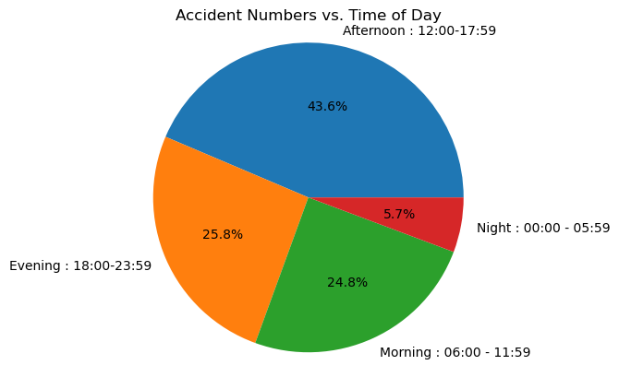
Analysis of Casualty Severities vs Time of Day- Jo
Question: When are accidents most likely to occur, based on time of day?
Filtered the data by combining accidents that have occurred during specific times of day into intervals, such that we can better assess when accidents are most likely to occur.
Morning - 06:00 - 11:59
Afternoon - 12:00 - 17:59
Evening- 18:00-23:59
Night- 00:00 - 05:59

Slide 4
Analysis of Casualty Severities vs Light Conditions- Jo
Question: What type of light conditions contribute to the severity of casualties?
In the government data file, the road safety key has defined values in column 'Light_Conditions' with the below keys-
1 : Daylight
4 : Darkness - lights lit
5 : Darkness - lights unlit
6 : Darkness - no lighting
7 : Darkness - lighting unknown
-1 : Data missing or out of range
It has also defined defined values in column 'Casualty_Severity' with the below keys--
1 : Fatal
2 : Serious
3 : Slight
We are going to combine the data under key 5 and 6, as both involve the roads being unlit. We will be dropping the data points from key 7 and -1 as this could potentially skew or create bias in our data because we do not know if the roads were lit or not.

Slide 5
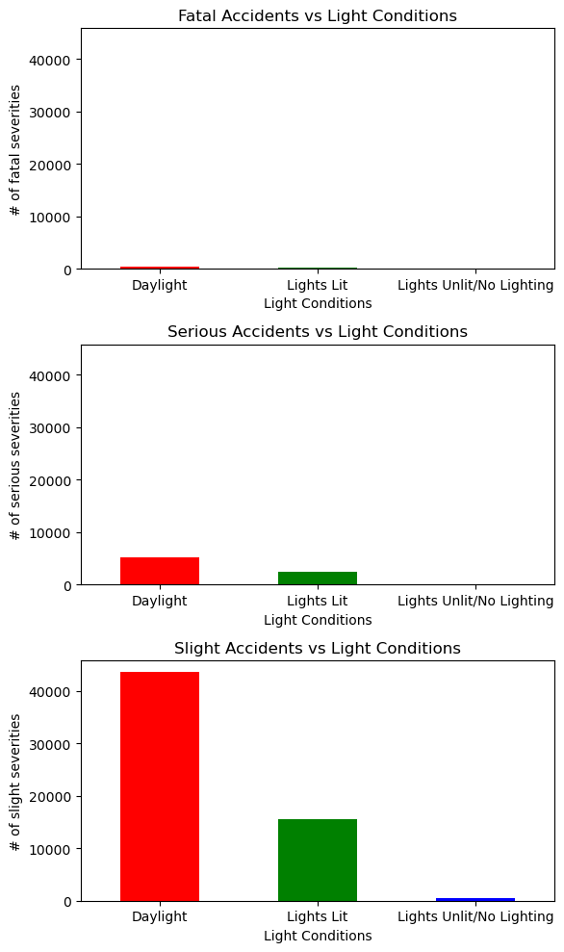
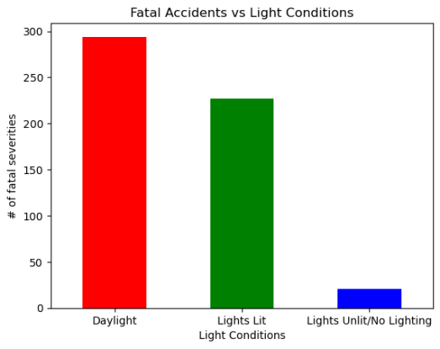
Analysis of Casualty Severities vs Light Conditions- Jo
Majority of accidents, happen during daylight hours – so what could be the reason for this?

Slide 6
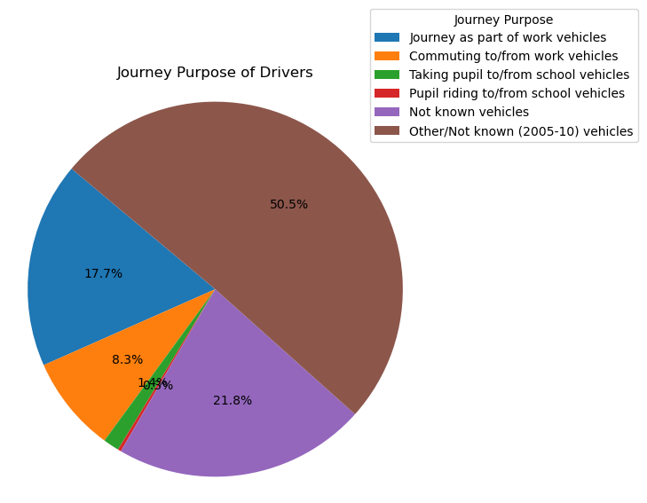
Journey Purposes
Question: why are most accidents happening in the daylight, then?
From the above bar plots, one can clearly see that accidents are happening when the roads are lit with daylight. This seems strange so we thought we would investigate this further. We wanted to see what the journey purpose was, as if most people are having accidents in the daylight hours, we would expect them to be doing school runs, work commutes etc.
The government data key shows the following, for values in column **'Journey_Purpose_of_Driver'**:
1 : Journey as part of work vehicles
2 : Commuting to/from work vehicles
3 : Taking pupil to/from school vehicles
4 : Pupil riding to/from school vehicles
5 : Other vehicles
6 : Not known vehicles
15 : Other/Not known (2005-10) vehicles
-1 : Data missing or out of range vehicles

